Slide 1
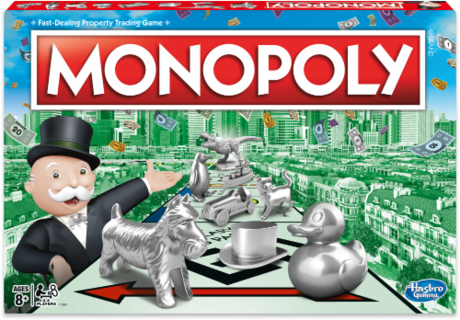
Exercice 3 : Monopoly Game

Slide 2
Classes to implement :
Player : string name, int position, bool inJail – multiple instances
Game : List of Players – single instance
GameBoard – single instance
PairOfDices – multiple instances

Slide 3
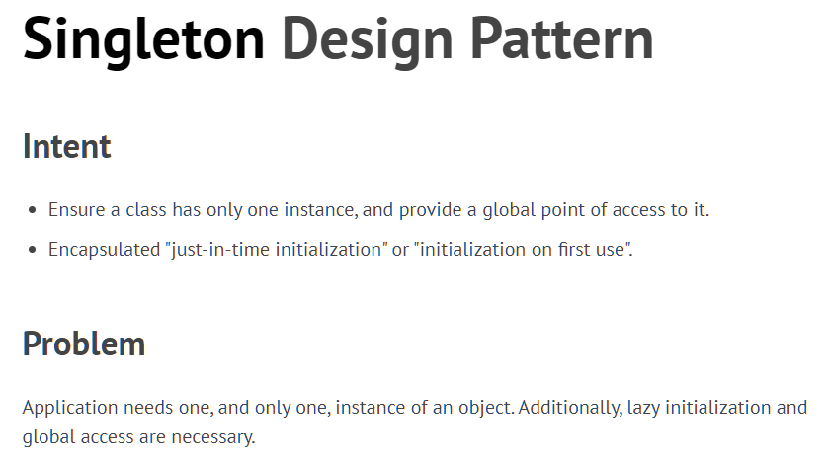

Slide 4
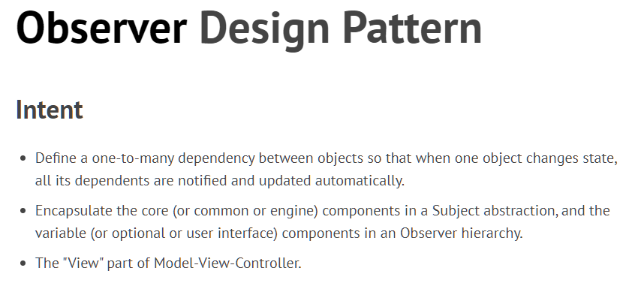

Slide 5
Desing Pattern Ideas
There will be multiple Players in the game, and their state (inJail or not) will change within the game !
Observer Pattern
There will be only one GameBoard
→ Singleton Pattern

Slide 6
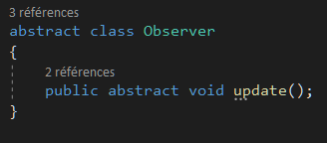
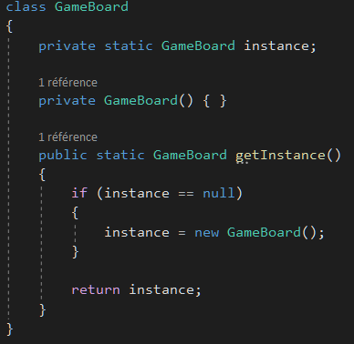
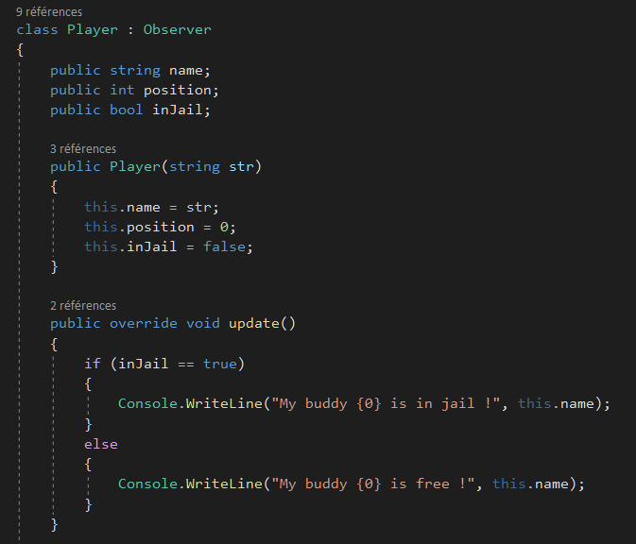
How to implement these Design Patterns ?
Singleton
Observer

